Slide 1
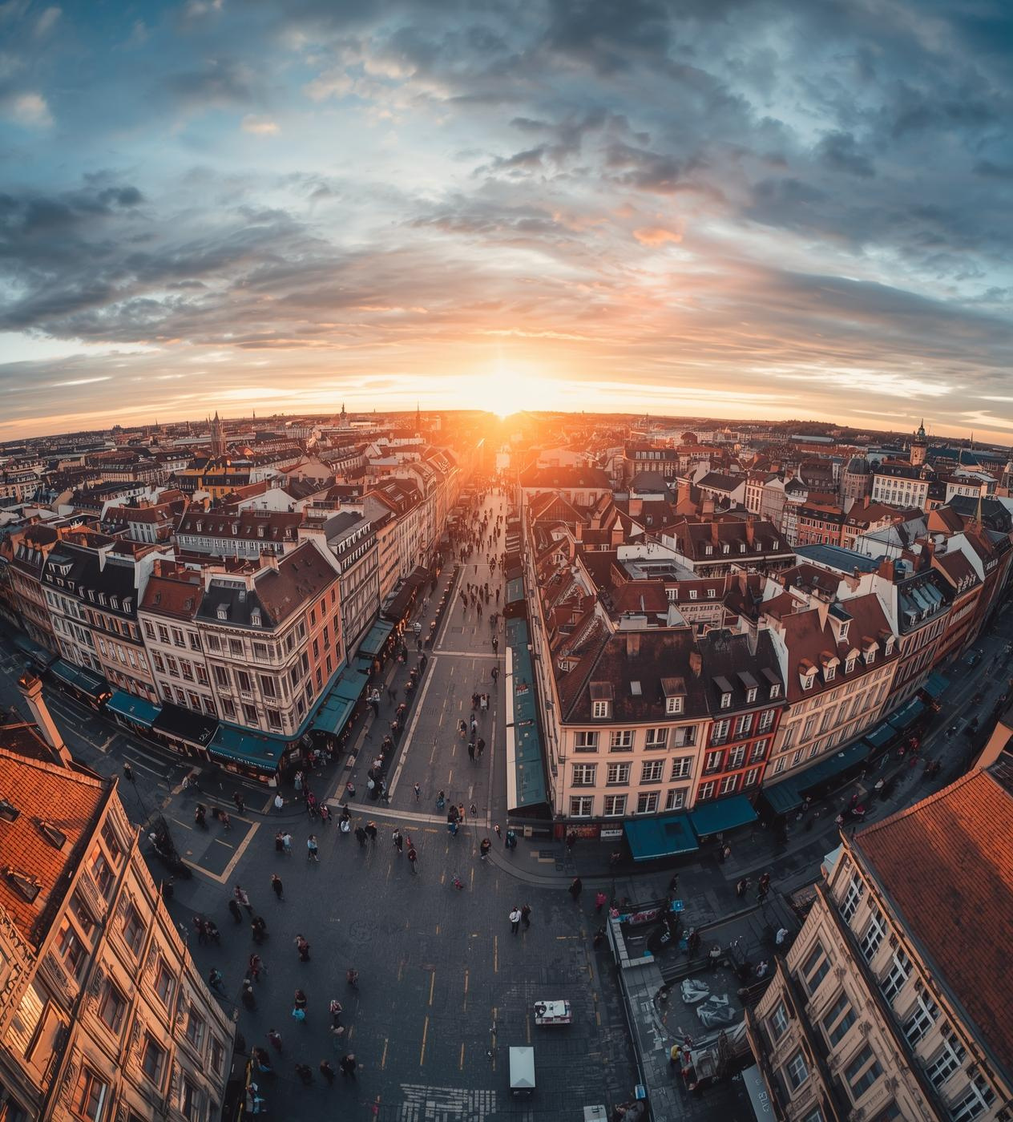

Lille, France
May 16 – 30, 2026

Slide 2
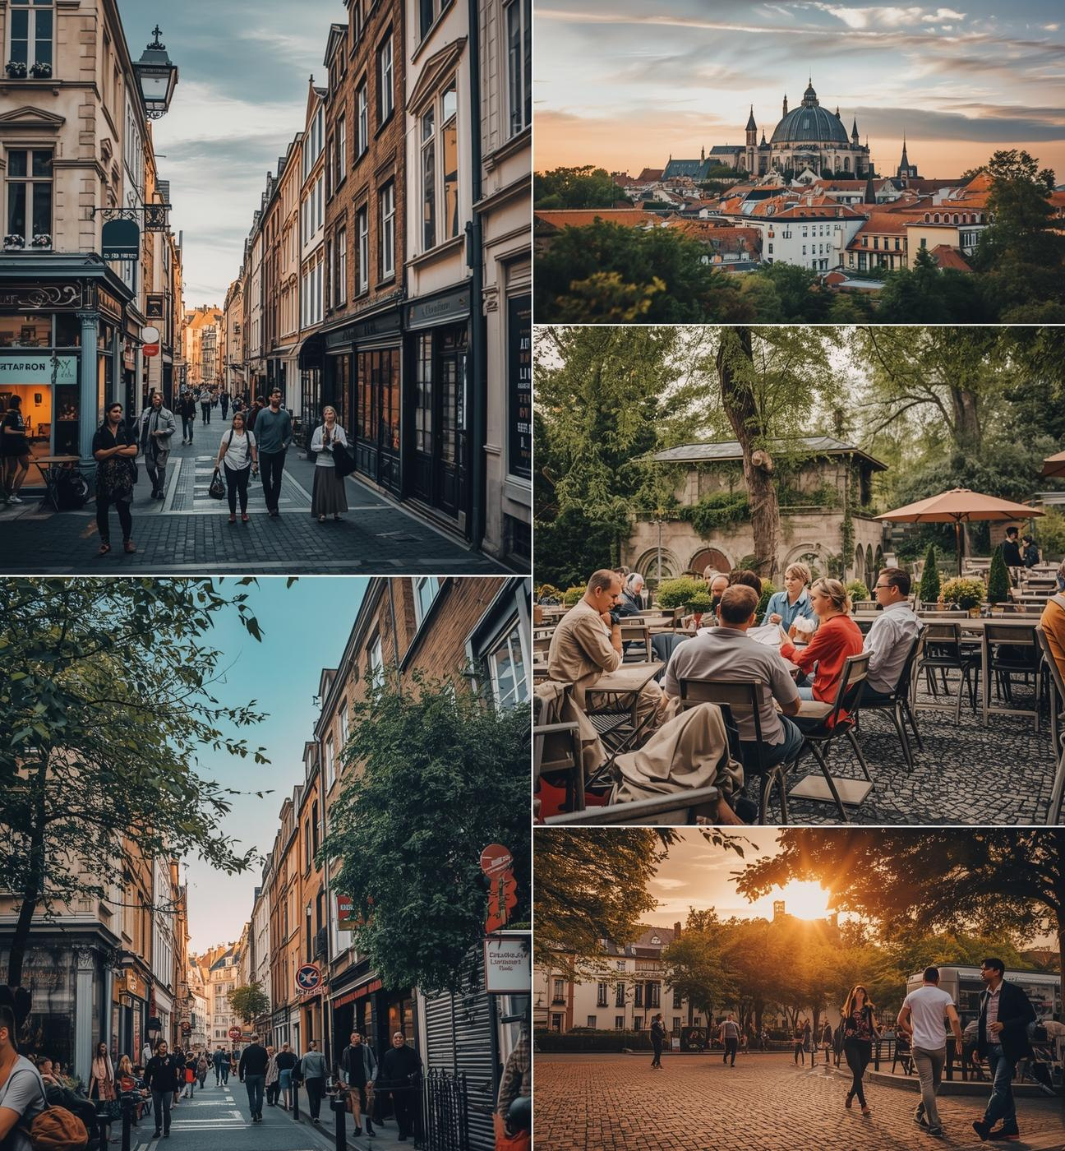
Lille
Lille is a dynamic university city that beautifully blends French and Flemish cultures. Its rich history, stunning architecture, and lively atmosphere make it an ideal backdrop for academic exploration. With close proximity to major European capitals, Lille serves as a perfect cultural gateway.

Slide 3

Academic Focus: International IP Law
International Intellectual Property
This is a 3-credit research seminar that allows students to examine the law and practice of intellectual property from a global perspective. In this seminar, we will study the structure, principles, and policies that underlie the international intellectual property system and analyze legal doctrines, statutes, and caselaw that relate to the protection and enforcement of patent, trademark, copyright, and other sui generis rights. Students will work with their professor to design and undertake an independent research project in an area of interest and learn to present and defend their research findings to their peers.

Slide 4
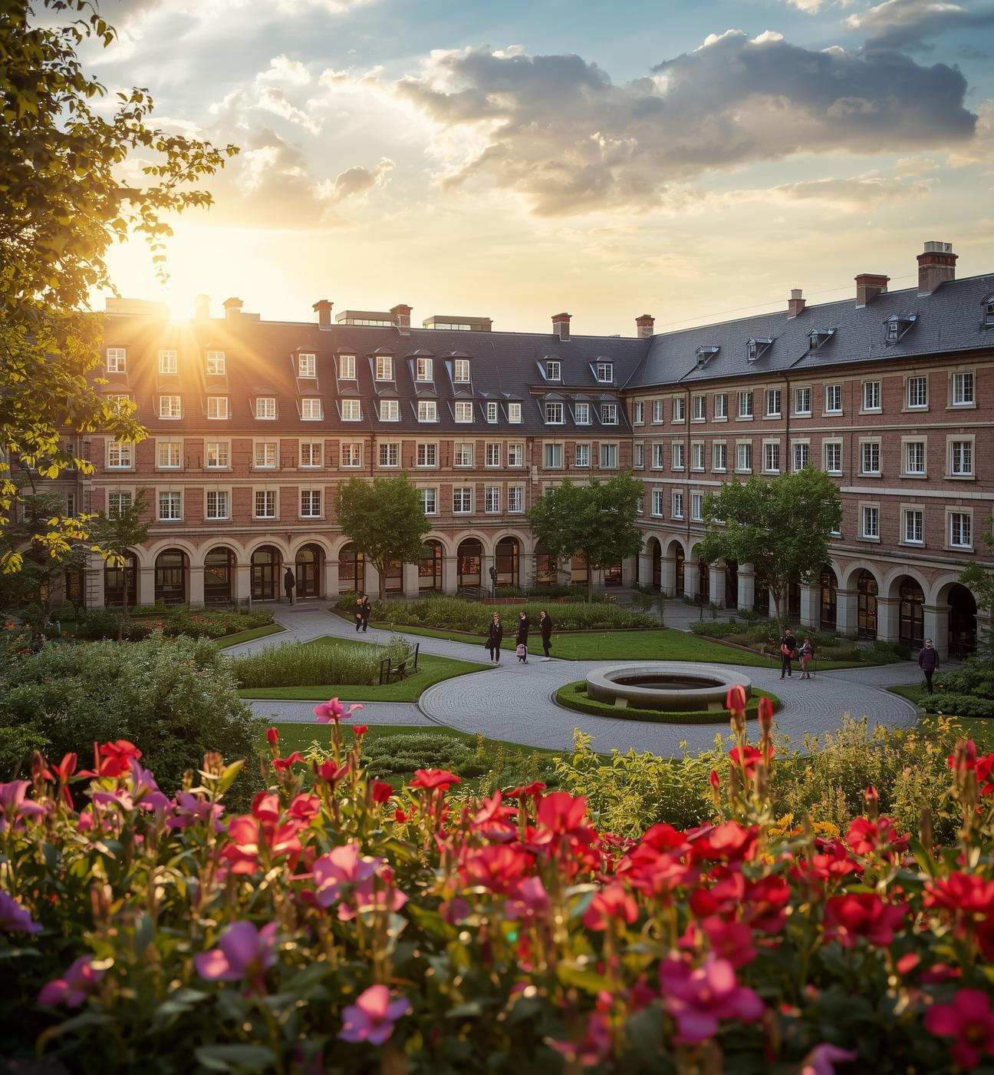
Universite Catholique de Lille
The Université Catholique de Lille is a prestigious private university known for its modern campus and strong emphasis on international collaboration. Students will enjoy state-of-the-art facilities, enhancing their educational experience while studying intellectual property law in France.

Slide 5

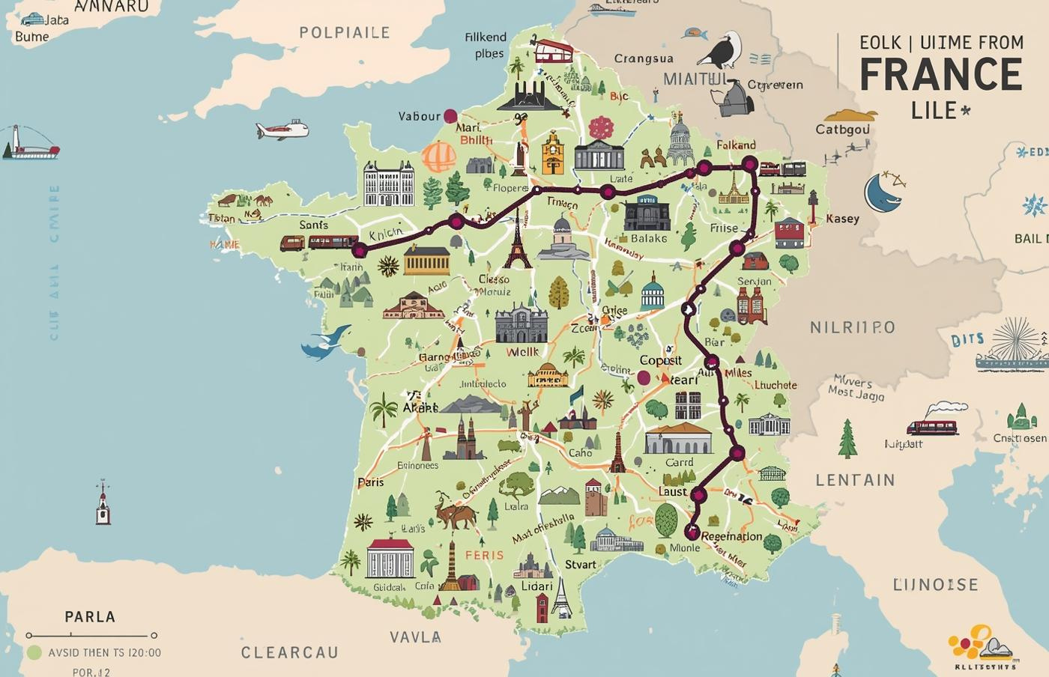
Travel Arrangements
Students will travel to Paris, then continue to Lille by train.

Slide 6
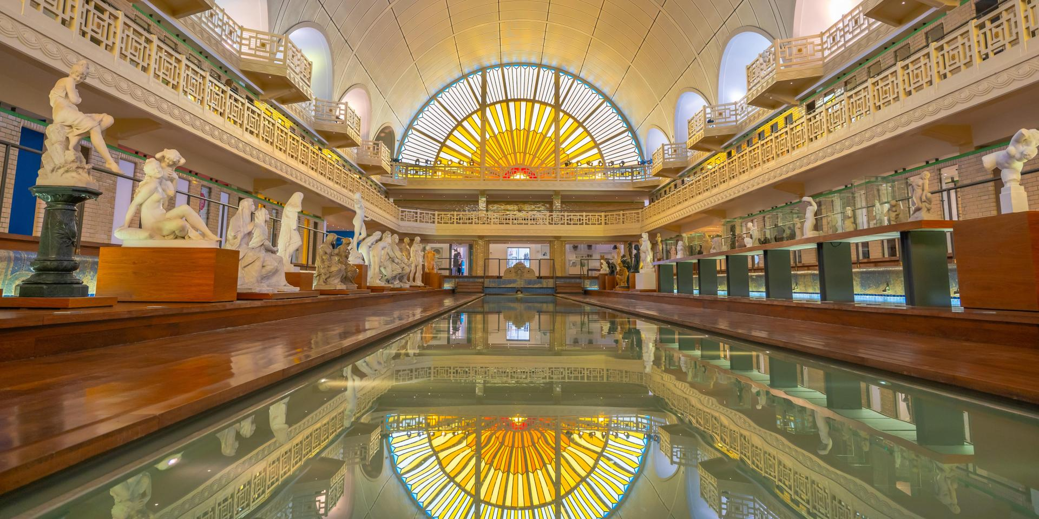
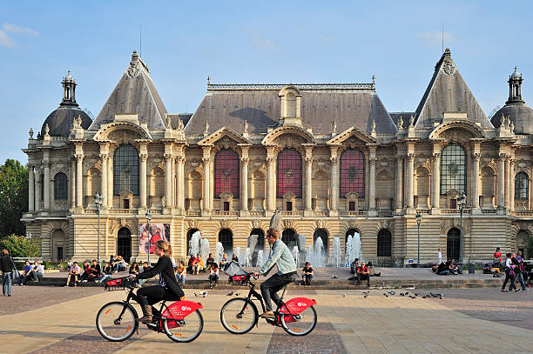
Possible Excursions
La Piscine
Lille Museums
Palais Des Beaux Arts Des Lille

Slide 7
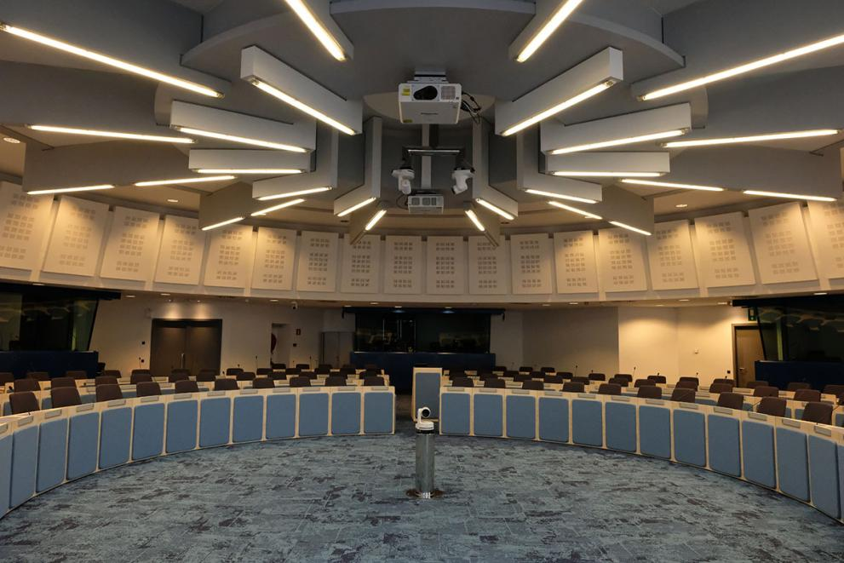
Possible Excursions
European Commission Visitor’s Centre and Experience Europe Exhibition
Brussels, Belgium

Slide 8
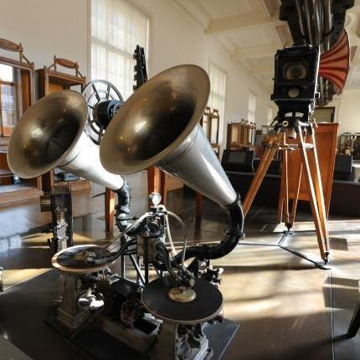
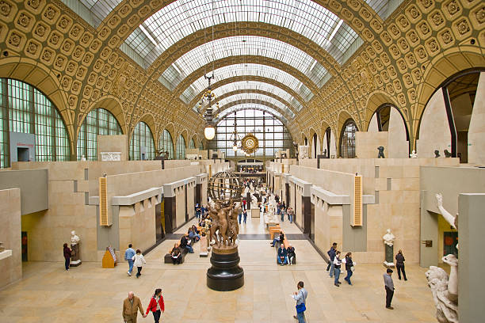
Possible Excursions
Musee des Arts et Metiers
Paris Museums
Musee d’Orsay

Slide 9

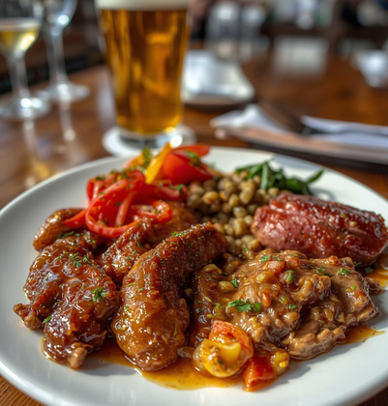
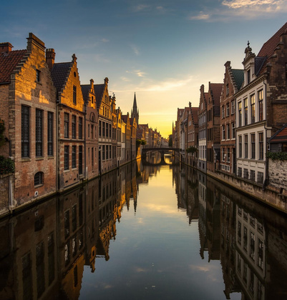
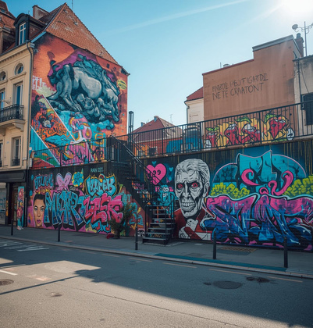
Cultural and Culinary Experiences
Local Markets
Flemish Cuisine
Experience the lively atmosphere of fresh produce.
Savor the rich flavors of local delicacies.
Day Trips
Street Art
Explore the picturesque beauty of Bruges canals.
Discover the vibrant art scene throughout Lille.

Slide 10
Venez avec nous!
CONTACT INFORMATION
Associate Dean Mary Purvis
mlpurvis@mc.edu

