Slide 1
Merida, Mexico
December 26-January 7
International Human Rights
3 credits

Slide 2
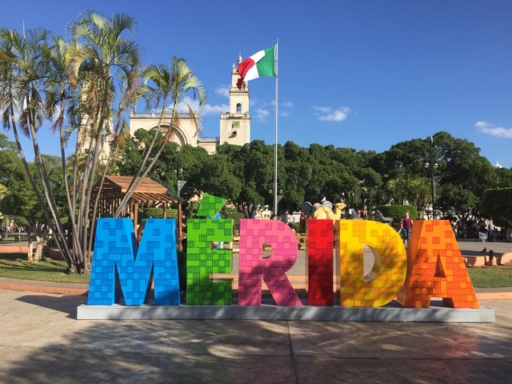
Merida
Capital of the State of Yucatan
Largest City in Southern Mexico
Founded 1542
Cultural Center of the Yucatan Peninsula

Slide 3
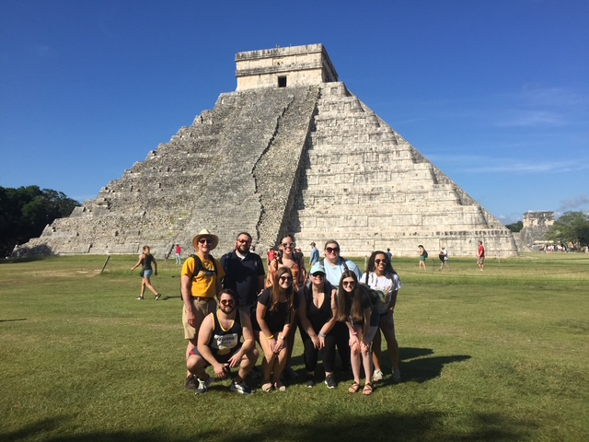
Chichen Itsa
World Heritage Site
Ancient Mayan city
600-1200 A.D.

Slide 4
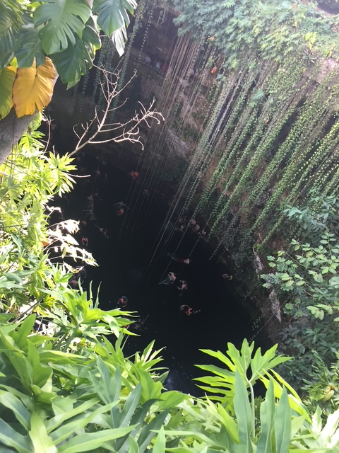
Swim in a cenote
Bring your swim suit!
Experience swimming in a cenote.

Slide 5
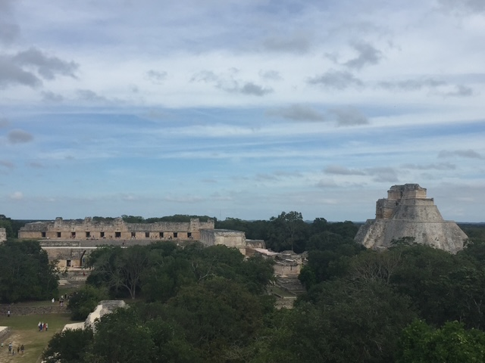
Uxmal
One of the most important Mayan cultural sites.
700 A.D.
World Heritage Site

Slide 6
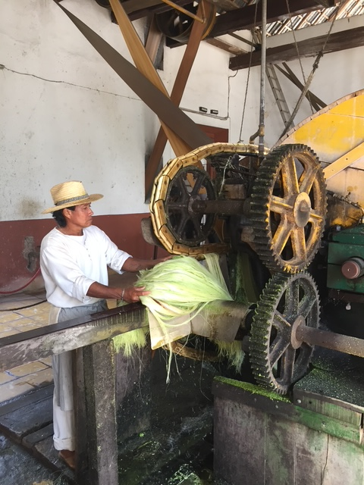
Hacienda Sotuta de Peón
Sisal plantation museum
Tour a living museum and learn about rope production before nylon and the riches it produced from underpaid labor.

Slide 7
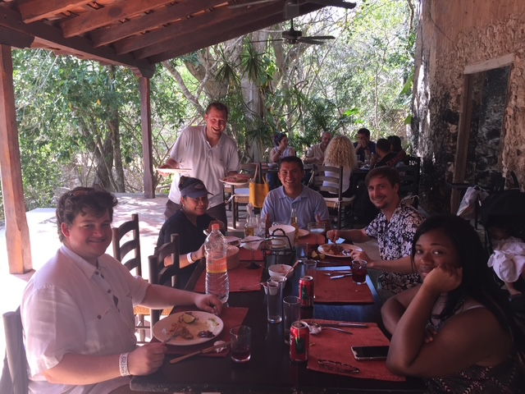
Traditional Mayan Food for Lunch at the Hacienda
Enjoy delicious traditional Mayan food.
Merida has great restaurants to choose from.

Slide 8
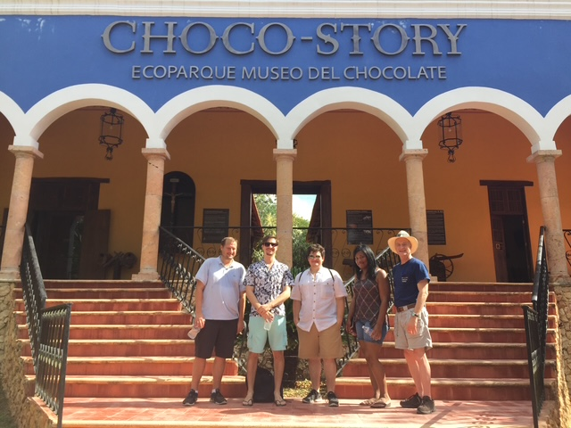
Choco-Story
Learn the history of chocolate at the chocolate museum!

Slide 9
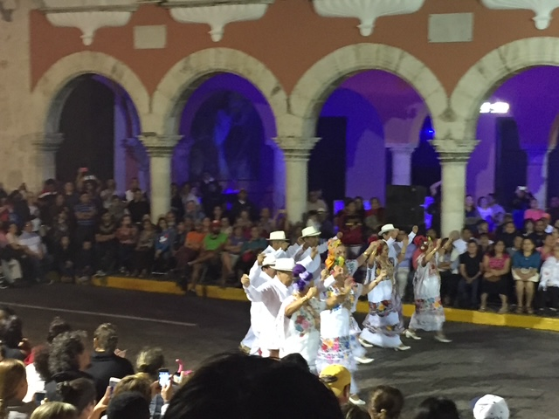
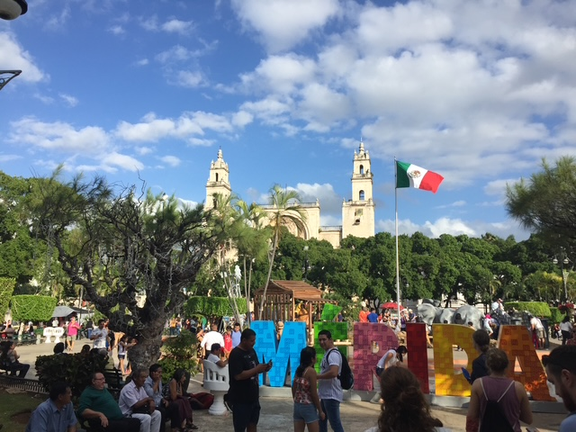
Explore the Culture of a Vibrant City While Learning about Human Rights

