Slide 1
Korea Program
Seoul, Korea

Slide 2
Courses in Korea
Dean Jim Rosenblatt instructor
Program runs from May 16 (Saturday evening)(arrival day) through May 29 (Friday 11:00 am)(able to depart Friday afternoon to return—will arrive in US on Friday)
Status of Forces Agreement for 2 credit hours—no textbook and open book exam
Government Contracting for 1 credit hour—no textbook and open book exam
Will hold 5 evening classes by Zoom in March/April 2026

Slide 3
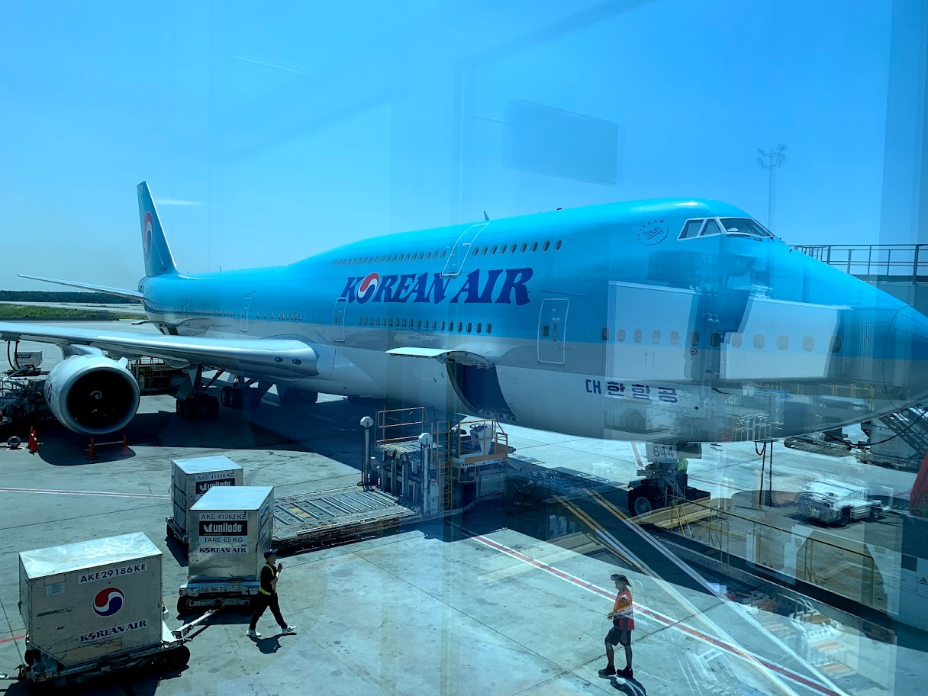
Seoul Airport Inchon or ICN

Slide 4
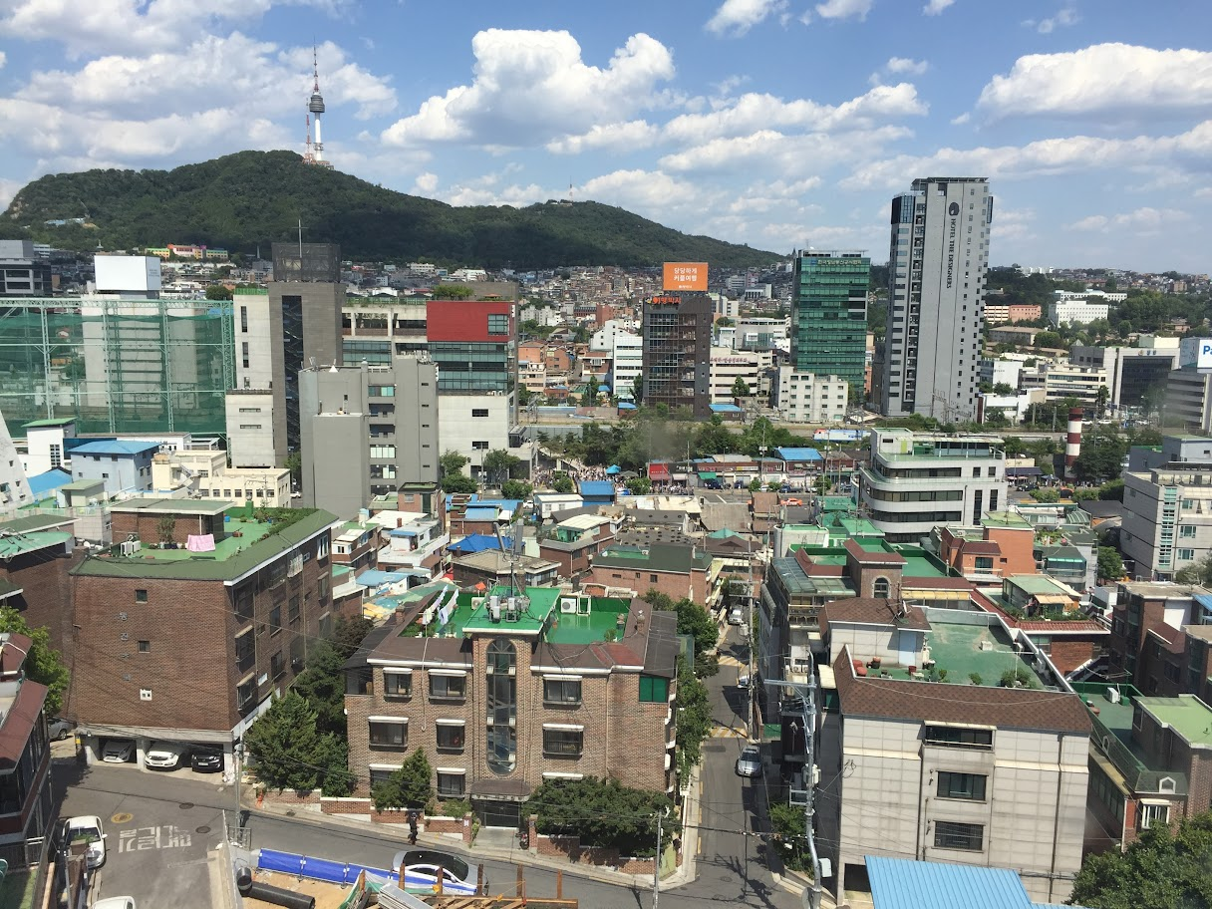
Densely Populated 10 Million in Metro Seoul

Slide 5
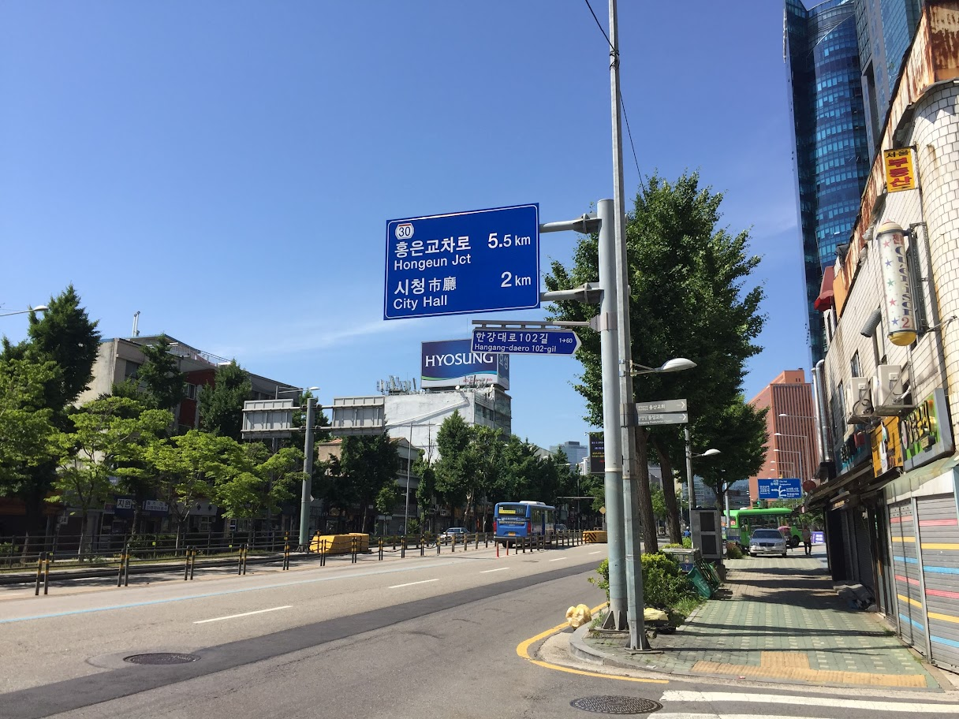
Street Scene Very Clean and Safe City

Slide 6
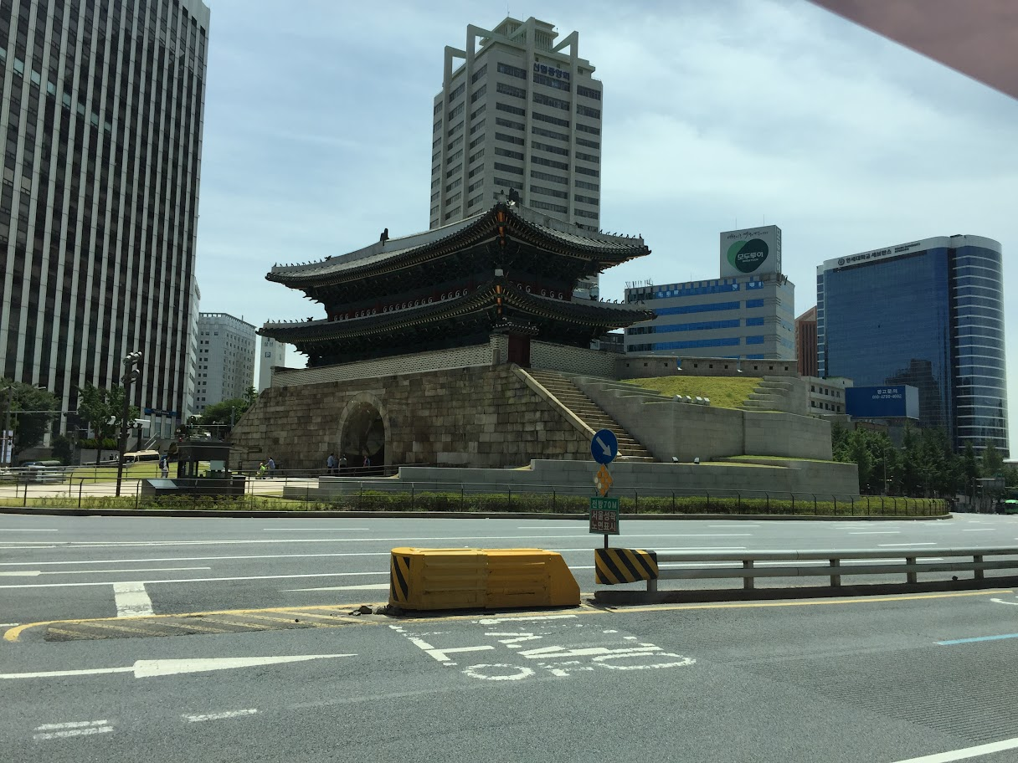
Old City Gate and New Skyscrapers

Slide 7
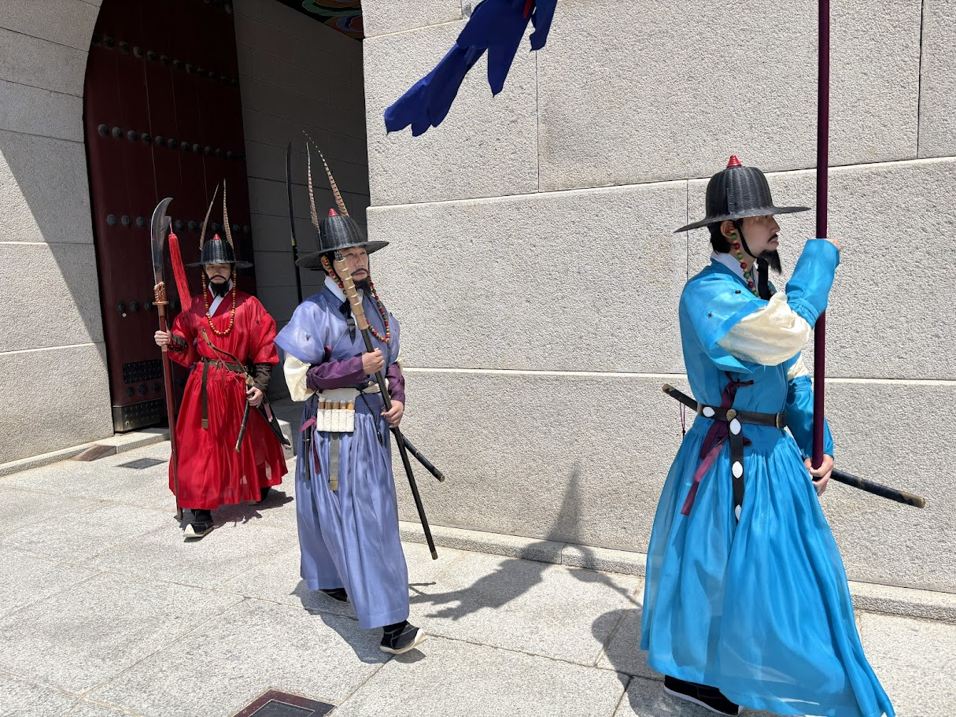
Traditional Garb

Slide 8
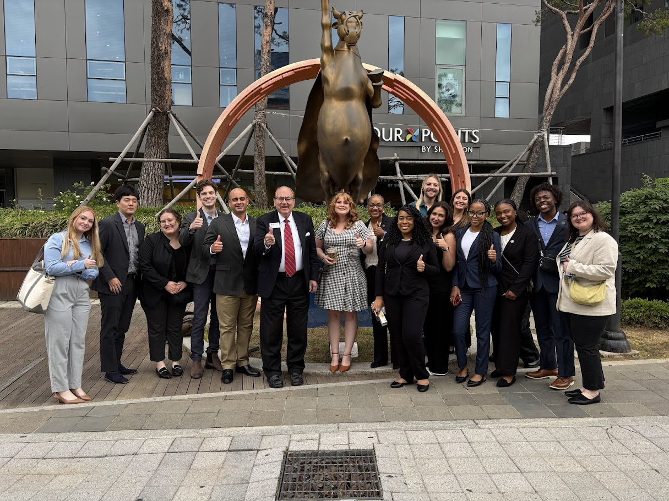
Sheraton Hotel near Seoul Station

Slide 9
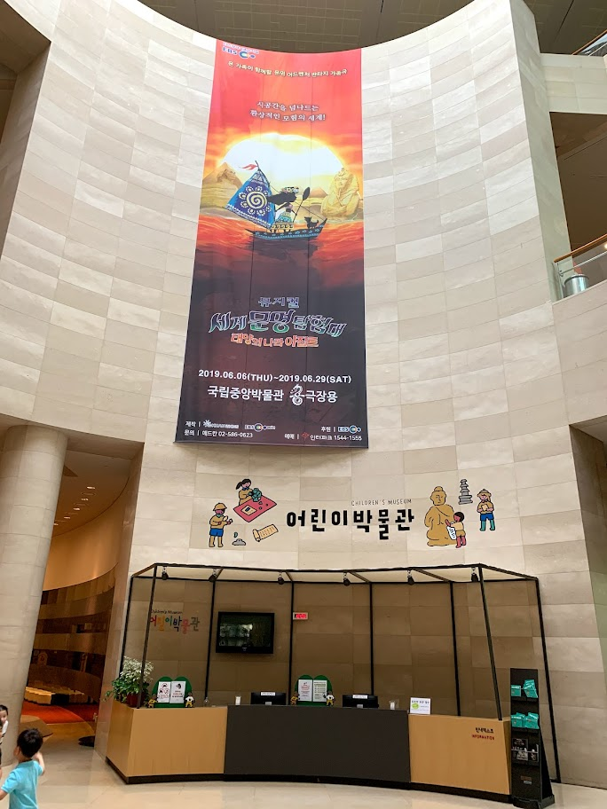
Korean National Museum

Slide 10
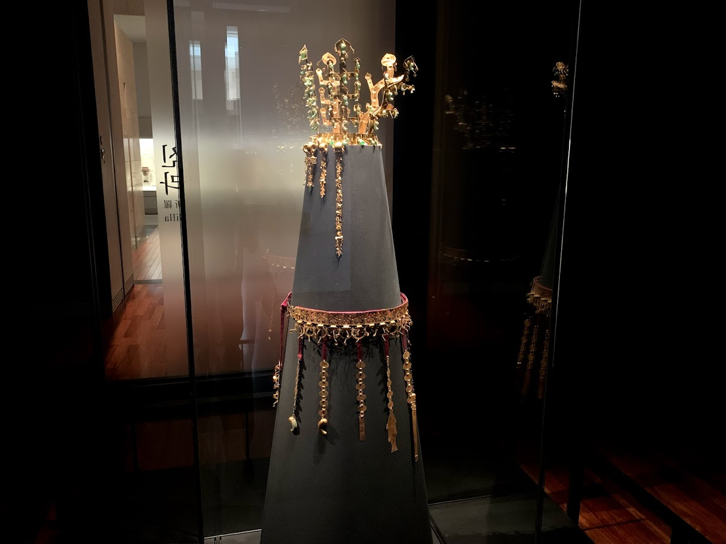
Korean Gold Artistry

Slide 11
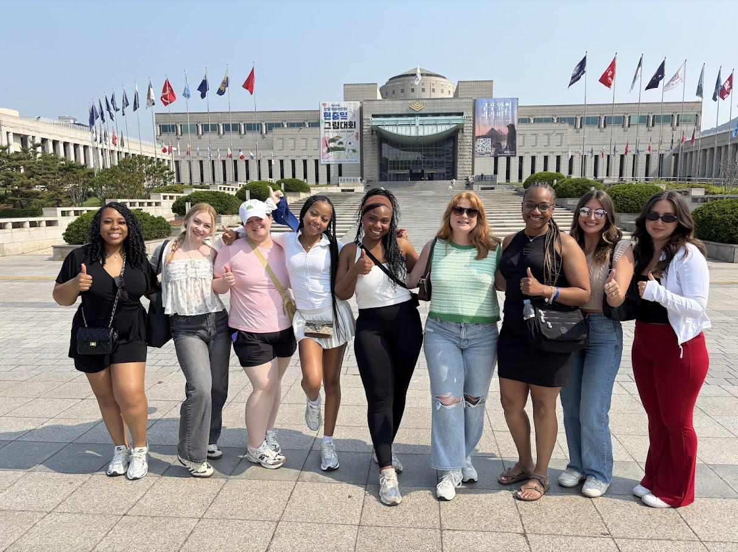
Korean War Museum

Slide 12
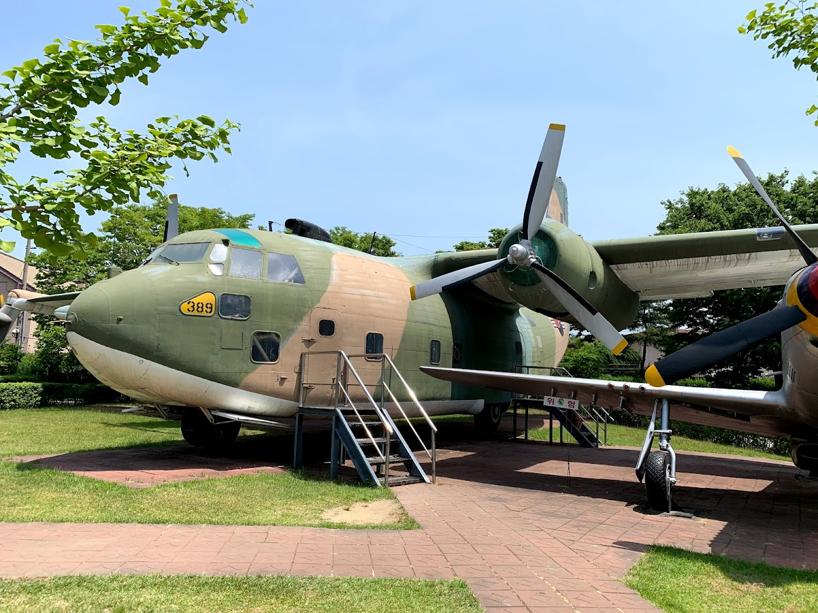
War Museum Static Display

Slide 13
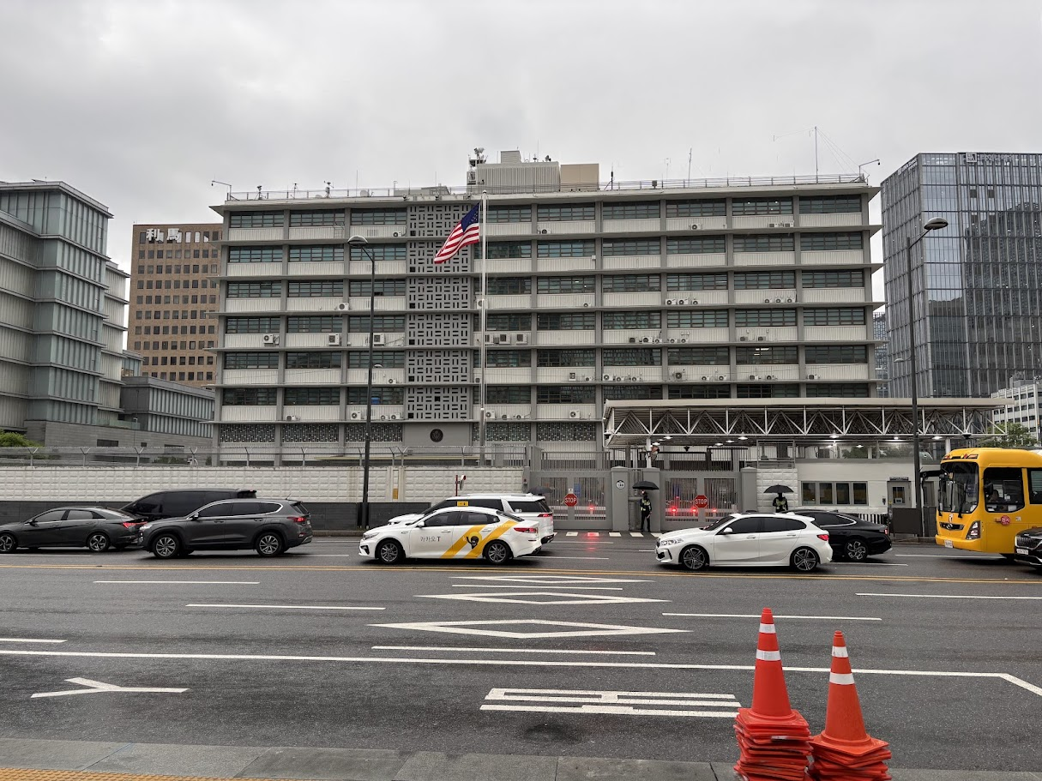
US Embassy

Slide 14
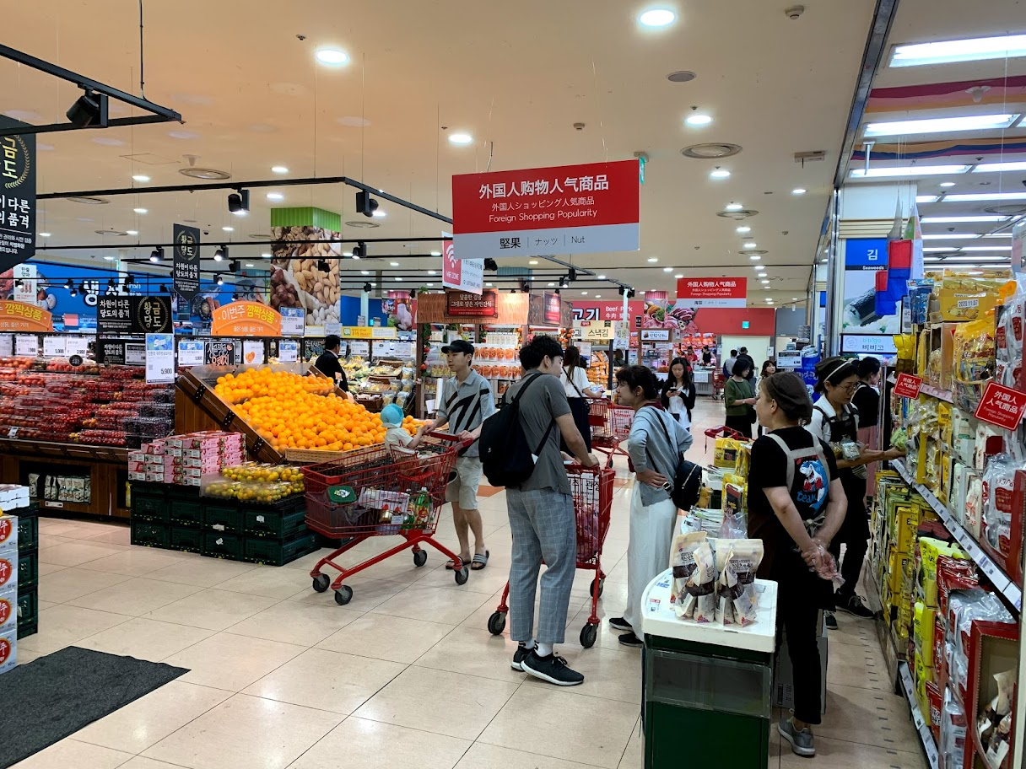
Korean Grocery Store

Slide 15
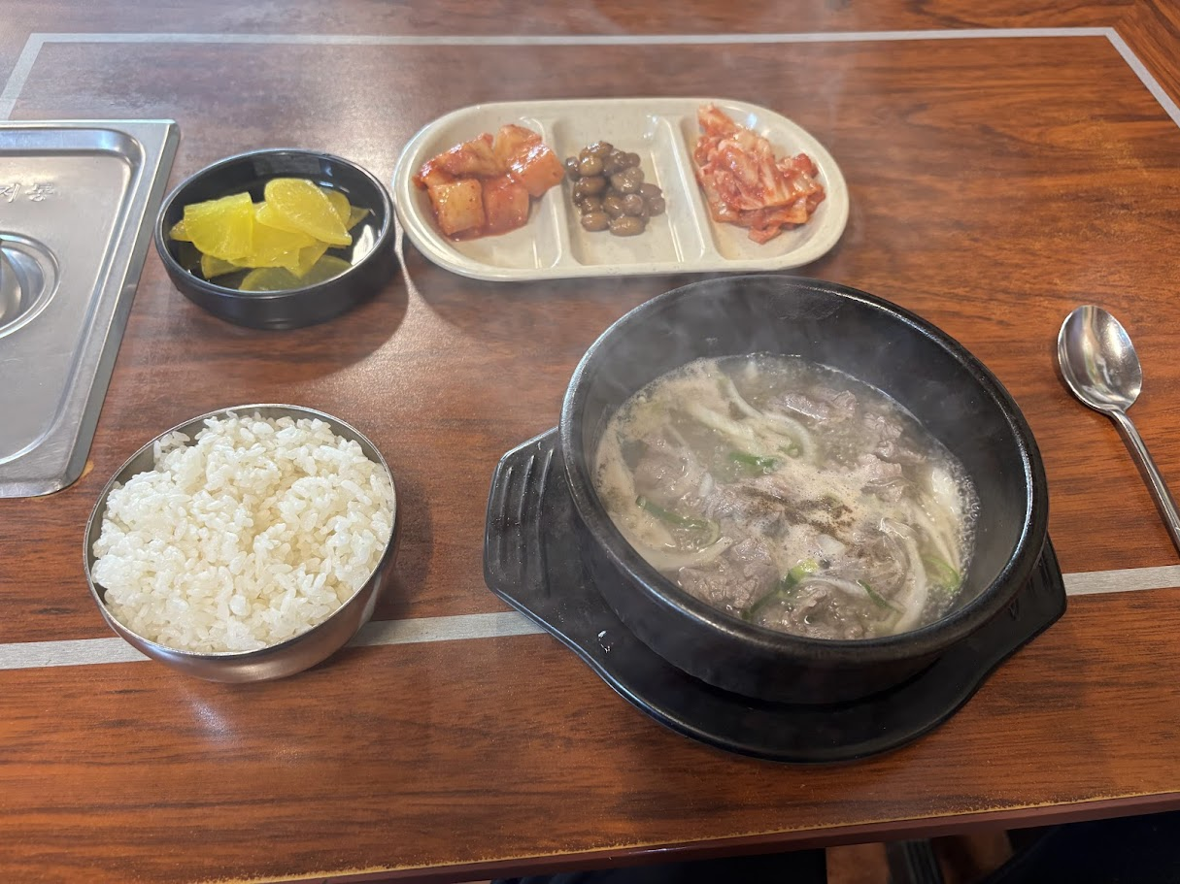
Korea Six Course Meal (about $8)

Slide 16
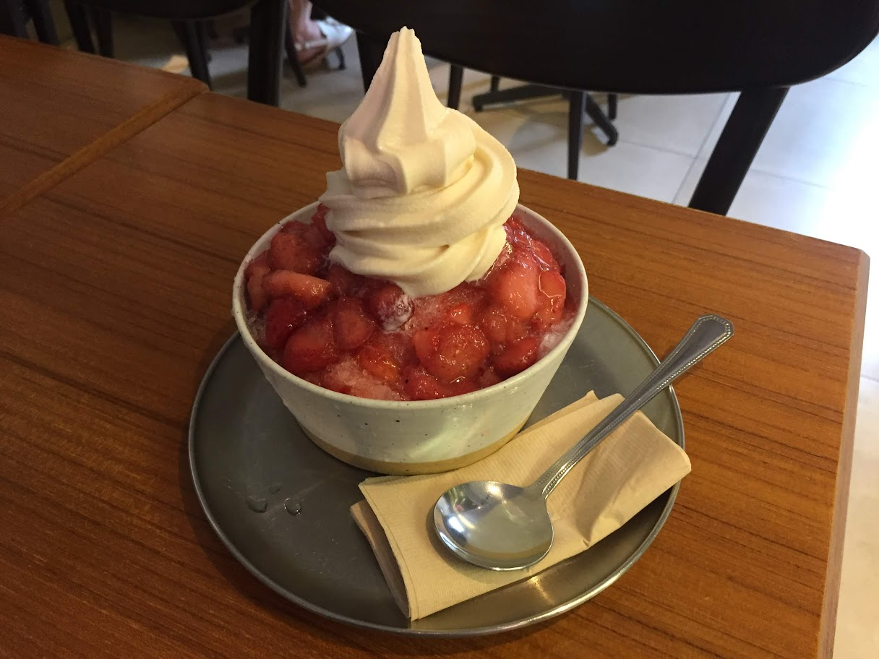
Refreshing Dessert

Slide 17
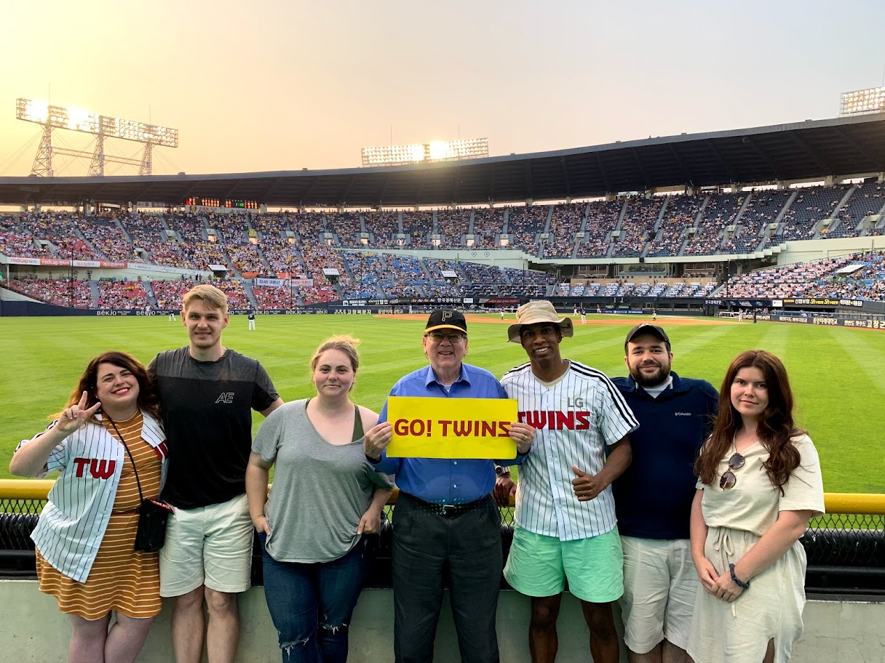
Korean Baseball Game

Slide 18
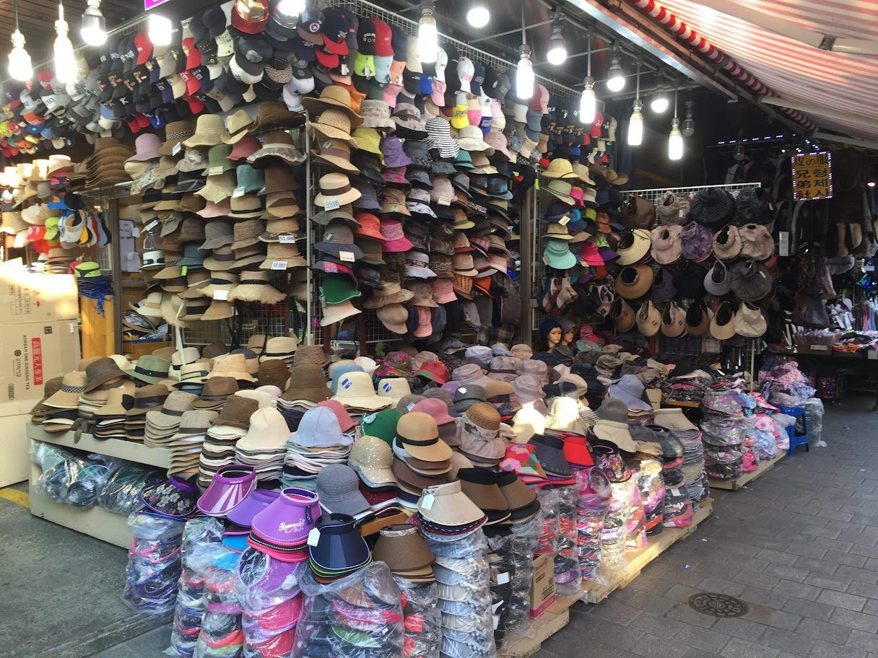
Korea Namdemung Market

Slide 19
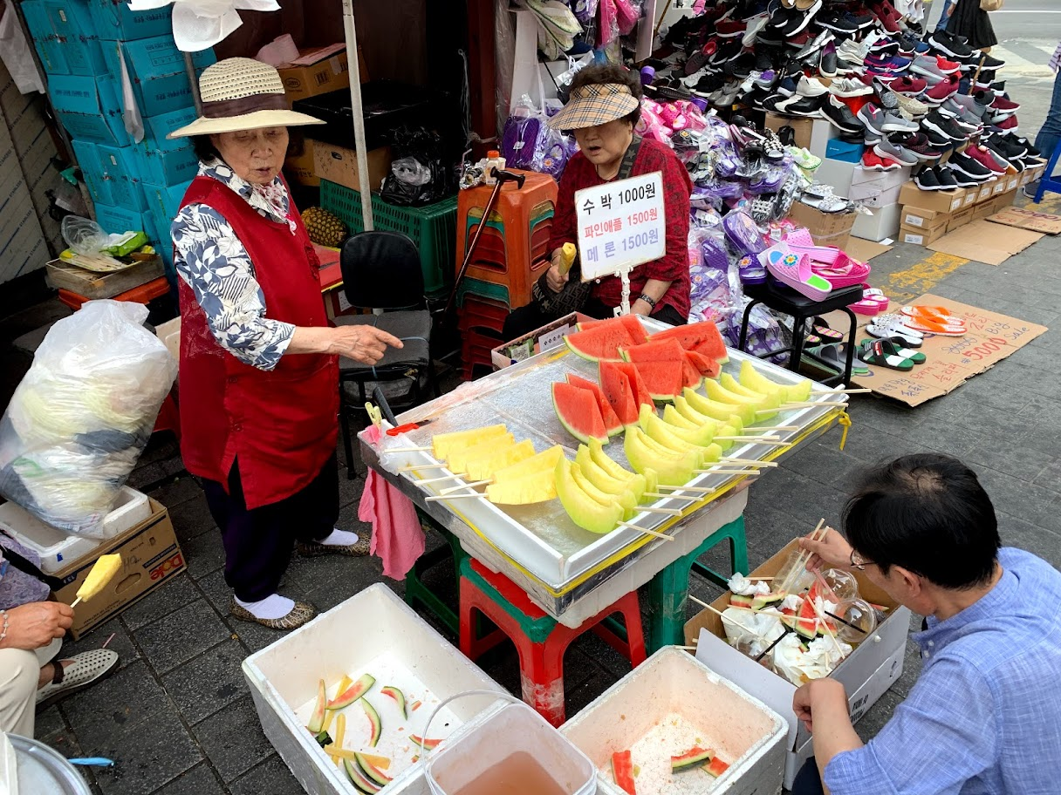
Market Fruit

Slide 20
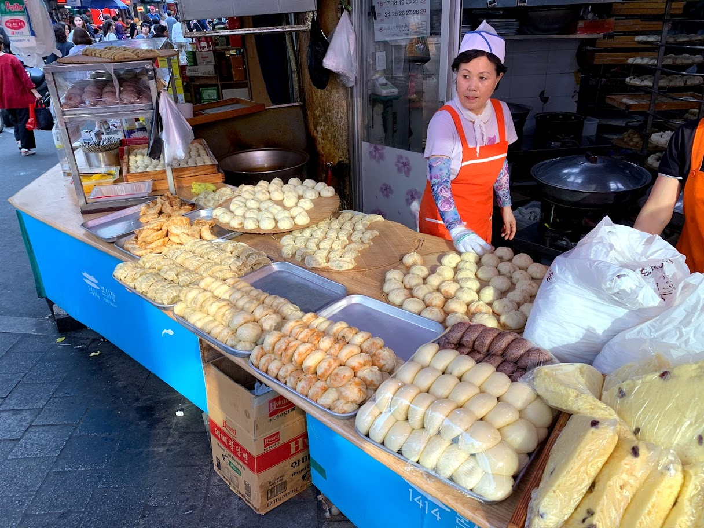
Market Bakery

Slide 21
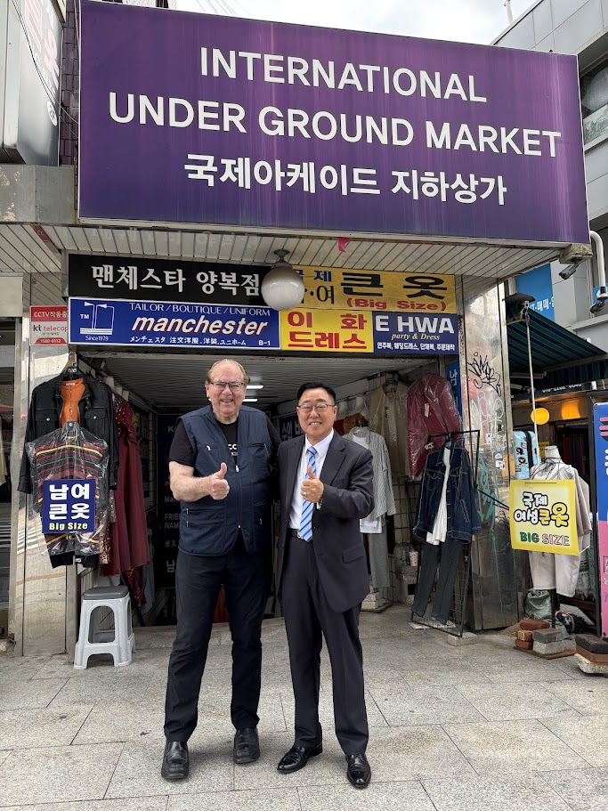
Tailor Shops (custom made suits)

Slide 22
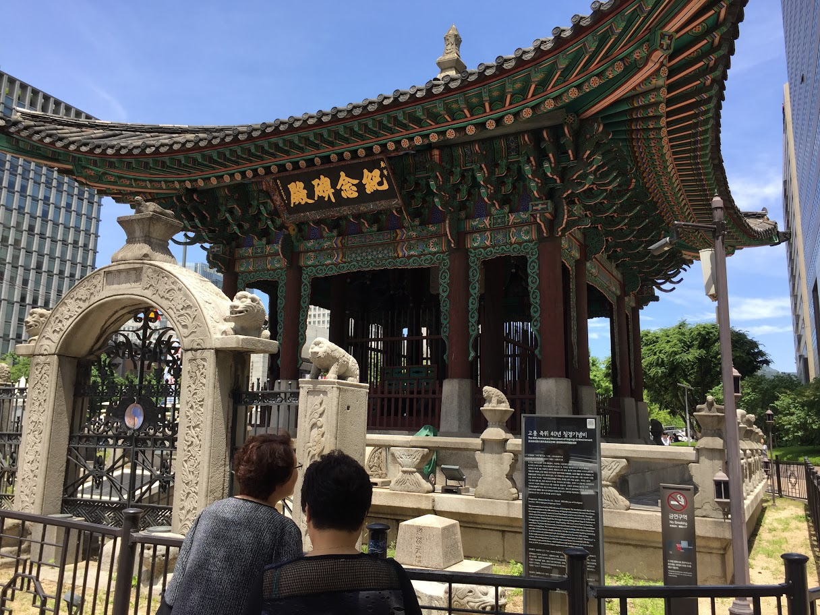
Majestic Temples

Slide 23
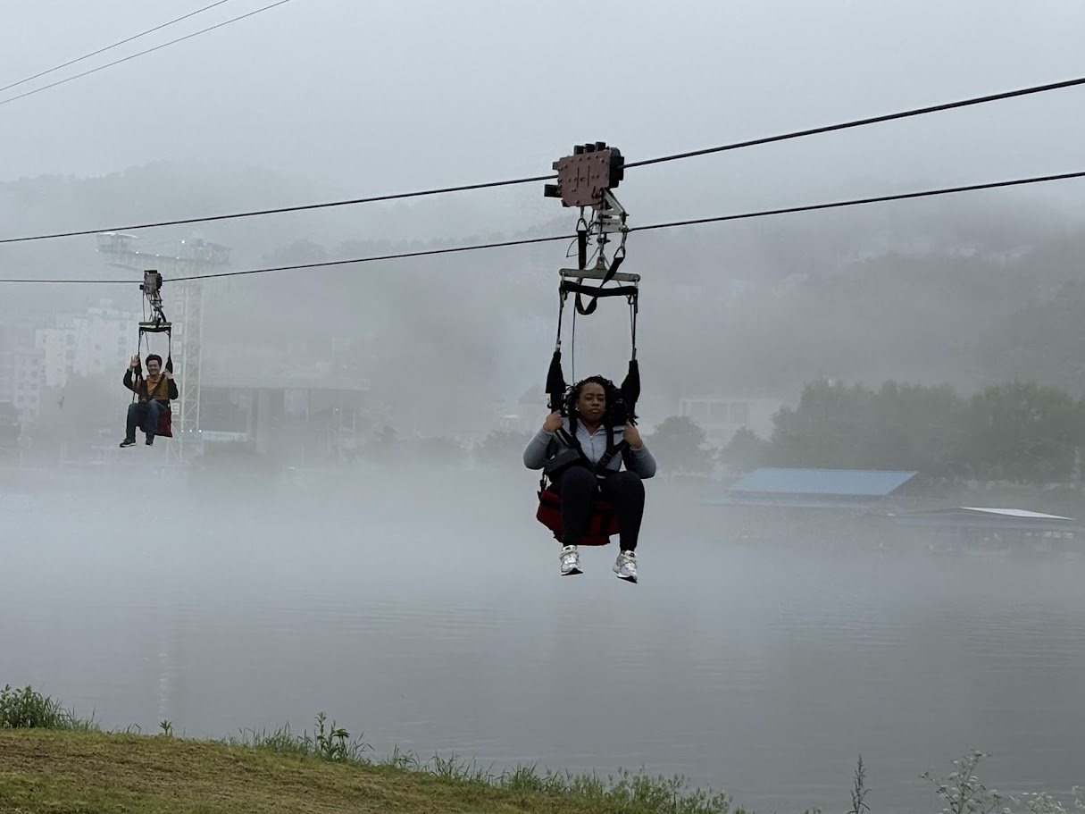
Namin Island

Slide 24
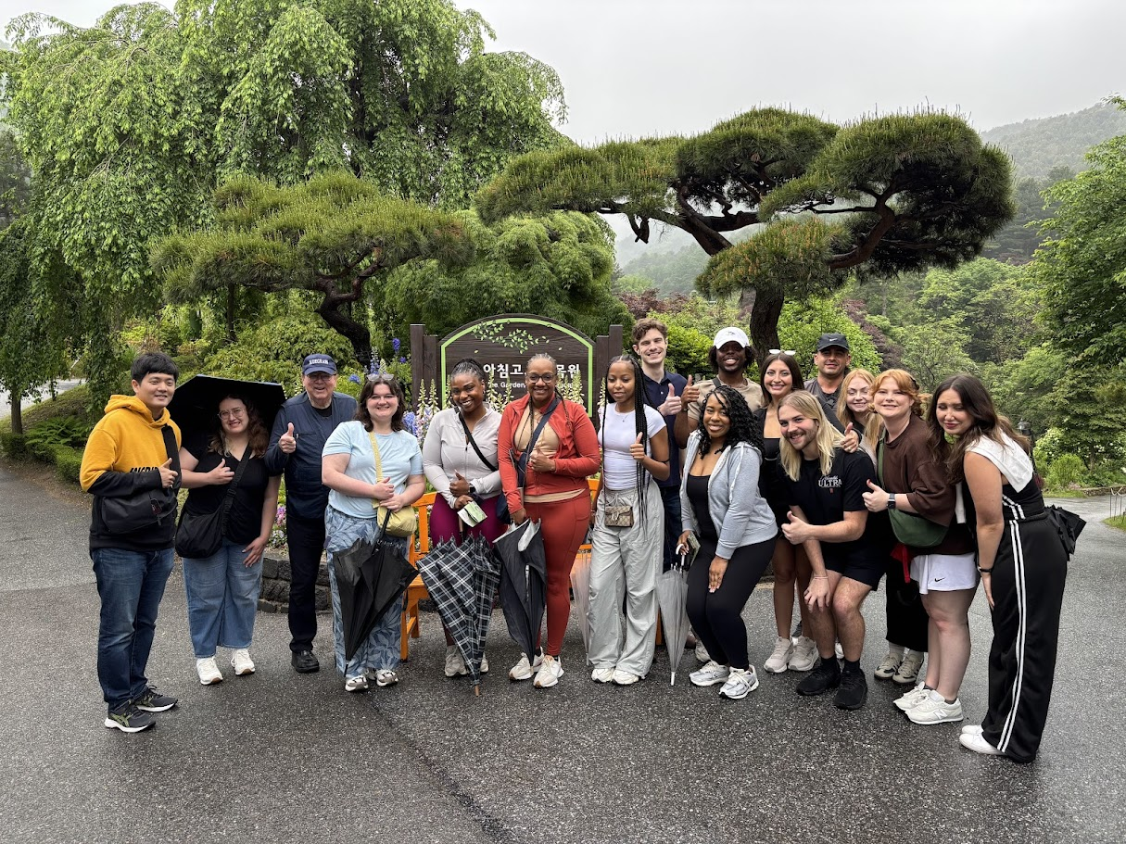
Garden of the Morning Calm

Slide 25
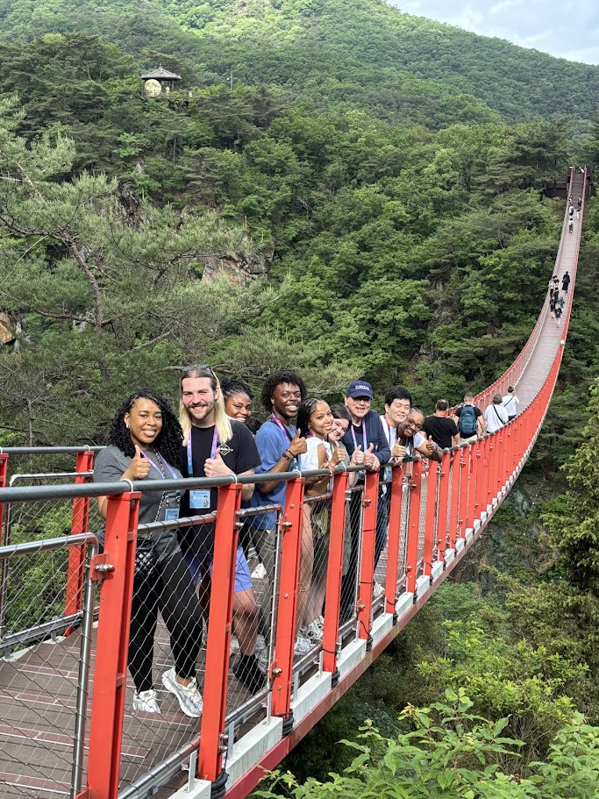
Suspension Bridge

Slide 26
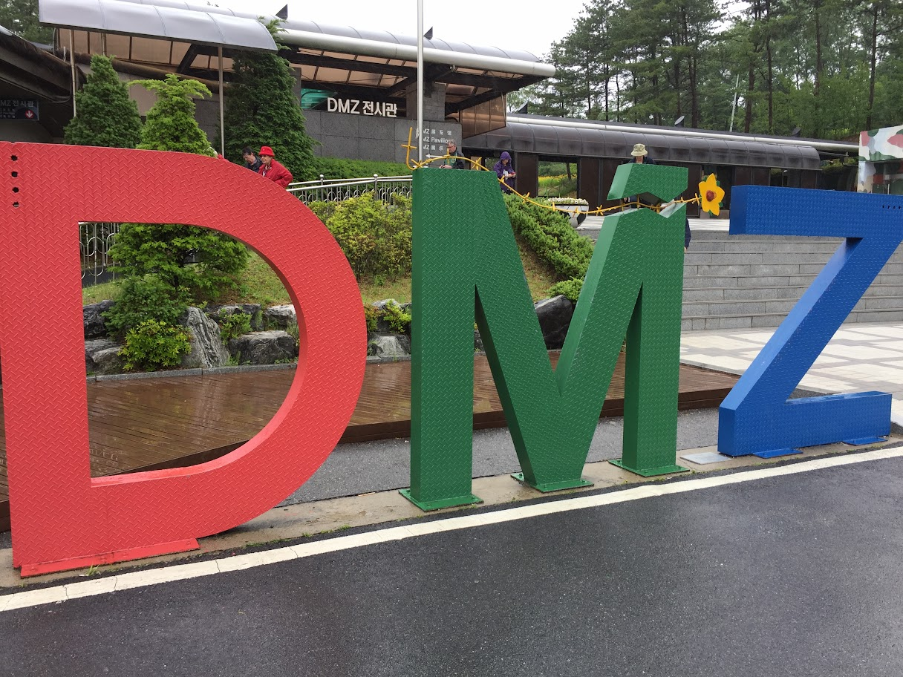
DMZ 38th Parallel

Slide 27
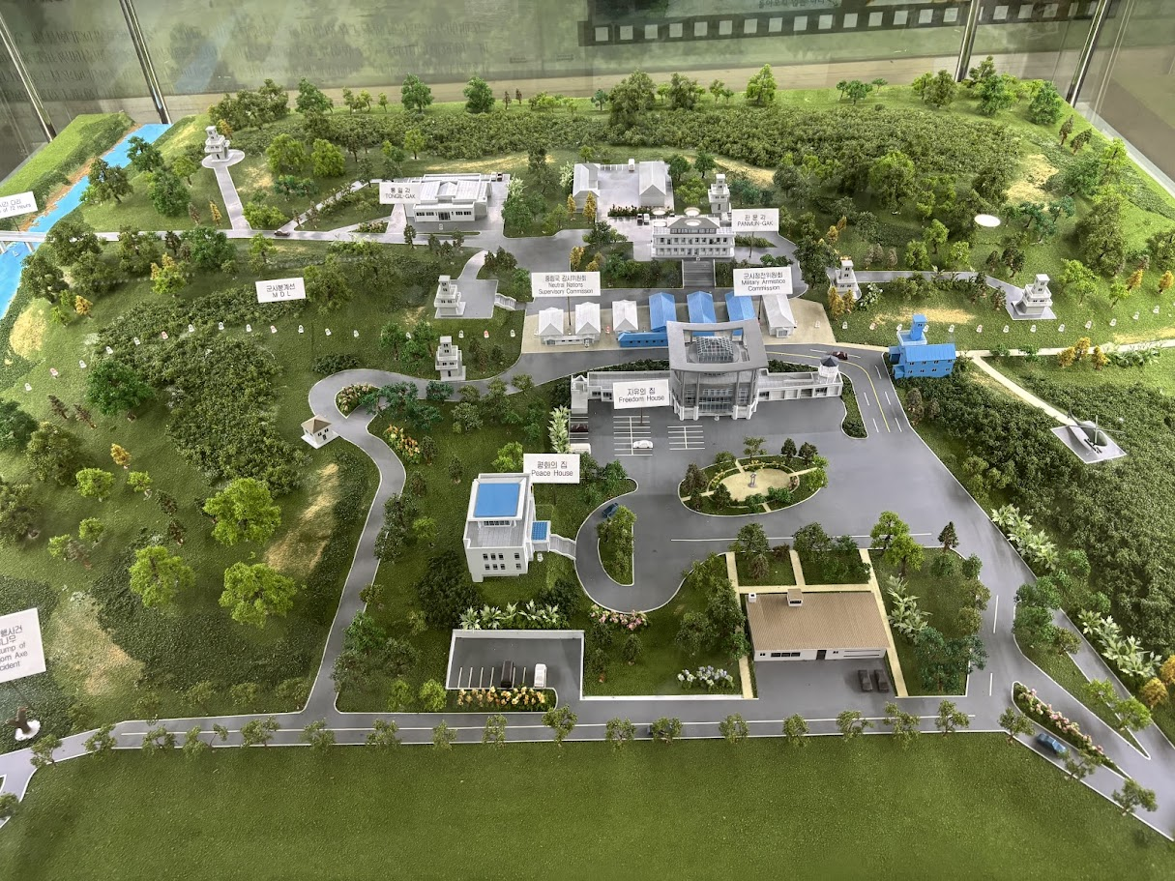
DMZ and North Korea

Slide 28
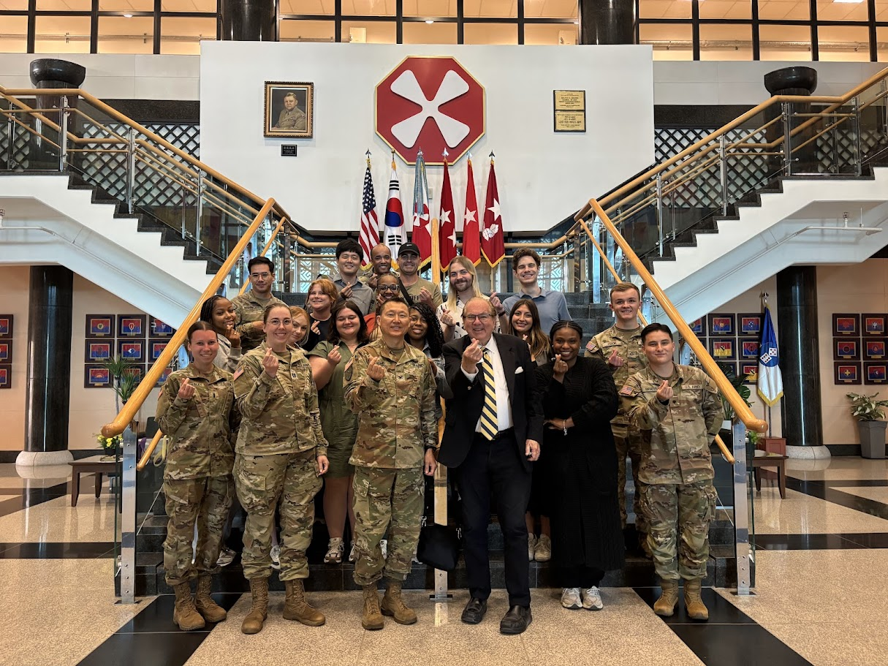
Camp Humphreys

Slide 29
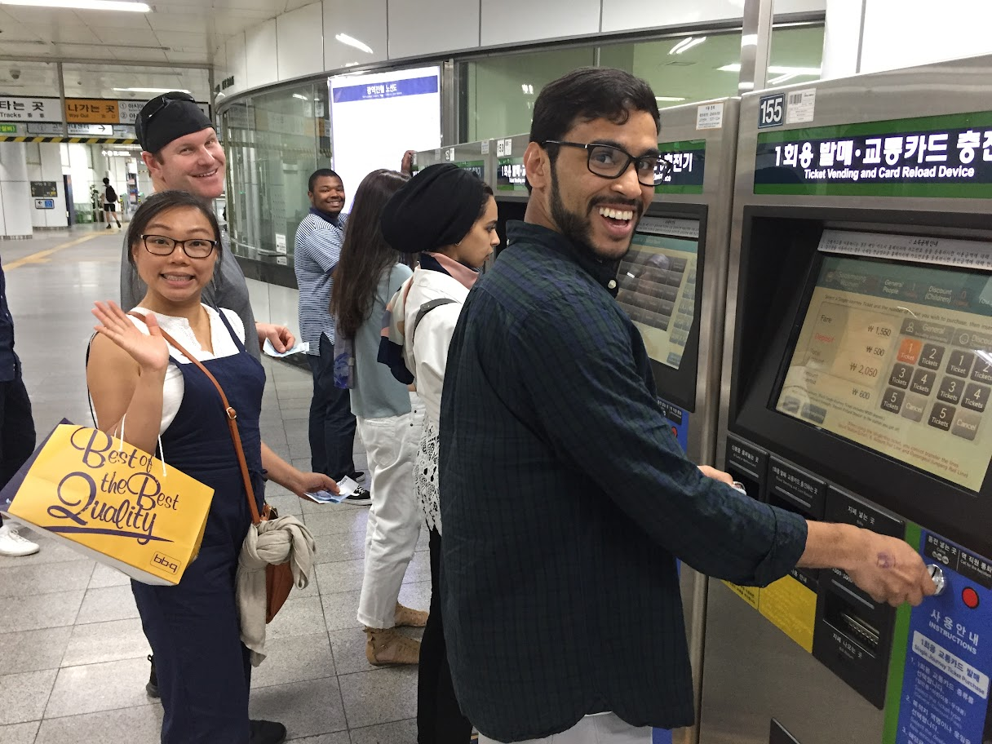
Modern City Transportation System

Slide 30
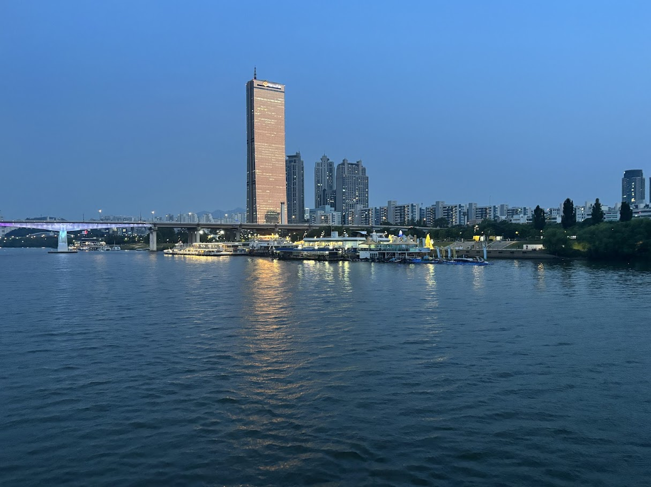
Han River

Slide 31
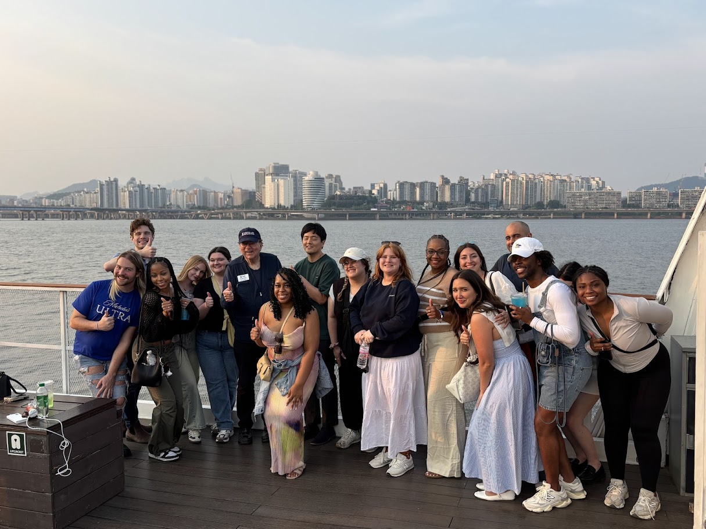
Han River Cruise

Slide 32
Invitation
Come join us and see the Far East and a dynamic and supportive ally and valuable trading partner.
Application form is on the website
Get passport—don’t delay
Pay $250 deposit to hold your place—first come, first served
Administrative fee can be put on your student account (approximately $3,100 to cover lodging, event transportation, entrance fees, events)
Air fare ranges from $1,900 to $3,000

